Slide 1
EIT x Soft Robots: project update
Week of Monday 26/04/2021

Slide 2
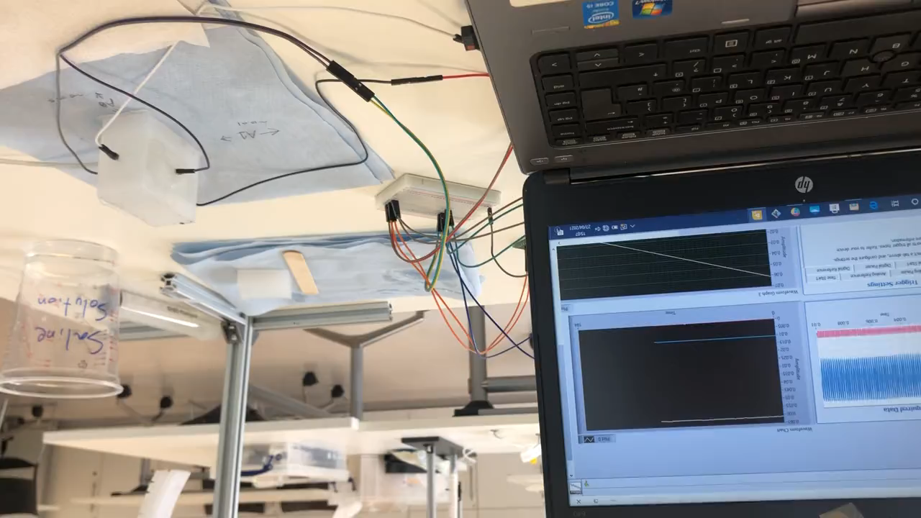
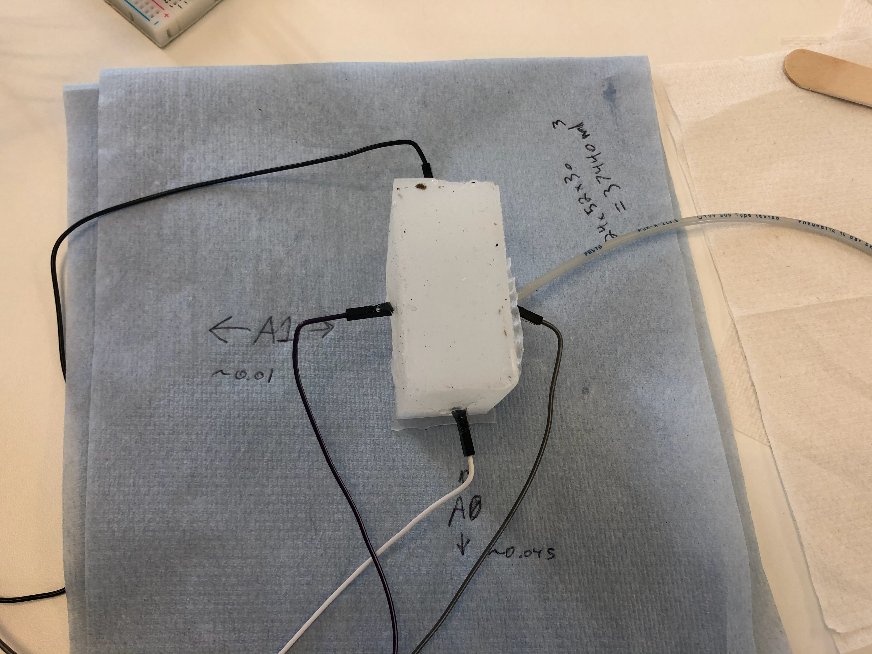
EIT two electrode pairs test
Blue line
A1
Voltages
A0
Yellow line
Time on x-axis

Slide 3
Investigations into flexible sealants
XTC-3D → not flexible
Evo-stik Flexible Silicone Sealant → viable

Slide 4
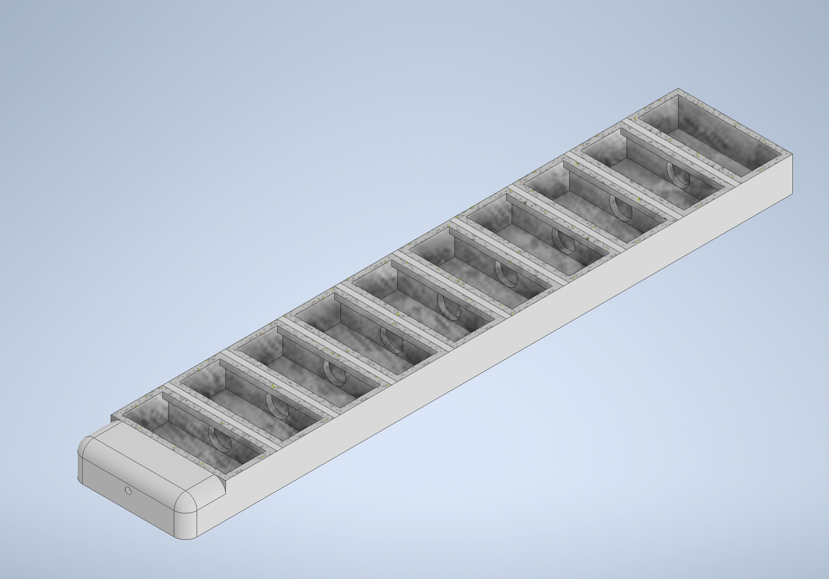
Investigations into electrode materials
Electrode placement
Silver epoxy → flexible? expensive
Other silver-based material → not flexible
New circle arch design

